Slide 1
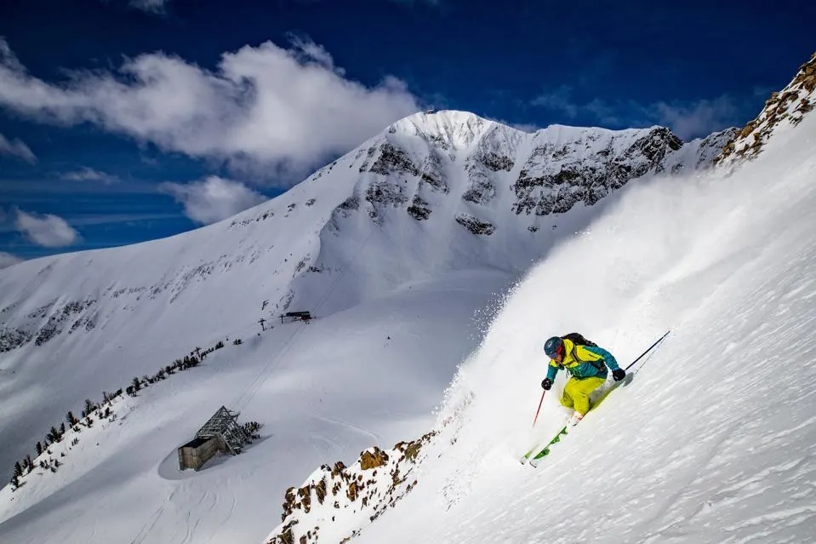
Big Mountain Ski Resort
Guided Capstone Case Study
By Adam Lang
4/2/2024
Springboard Data Science Fellow
Notes:
Welcome resort management to my presentation to our stakeholders regarding recent controversy around the installation of a new state of the art ski lift at Big Mountain Resort that is going to risk increasing our operating expenses by $1.5 million. I hope that you leave this presentation with ideas, insight and direction.

Slide 2
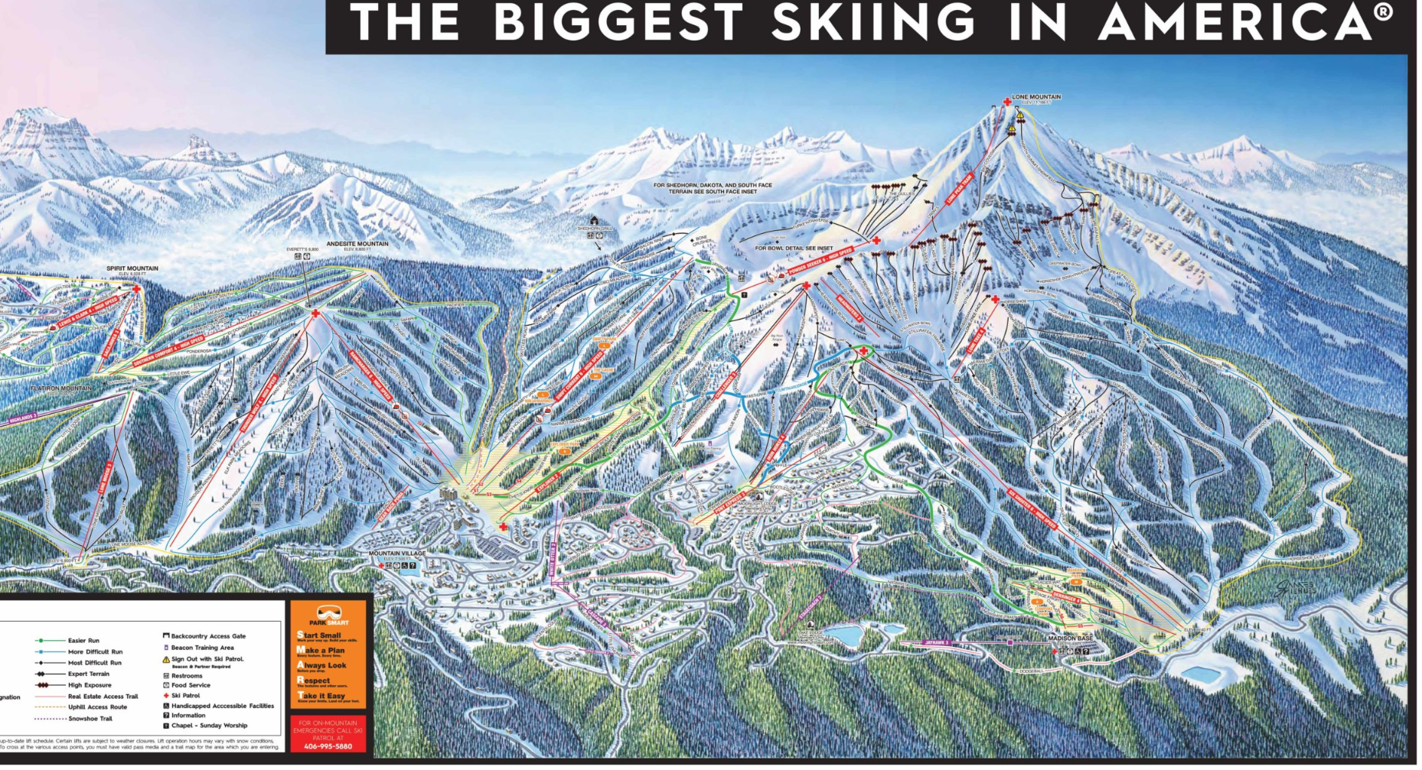
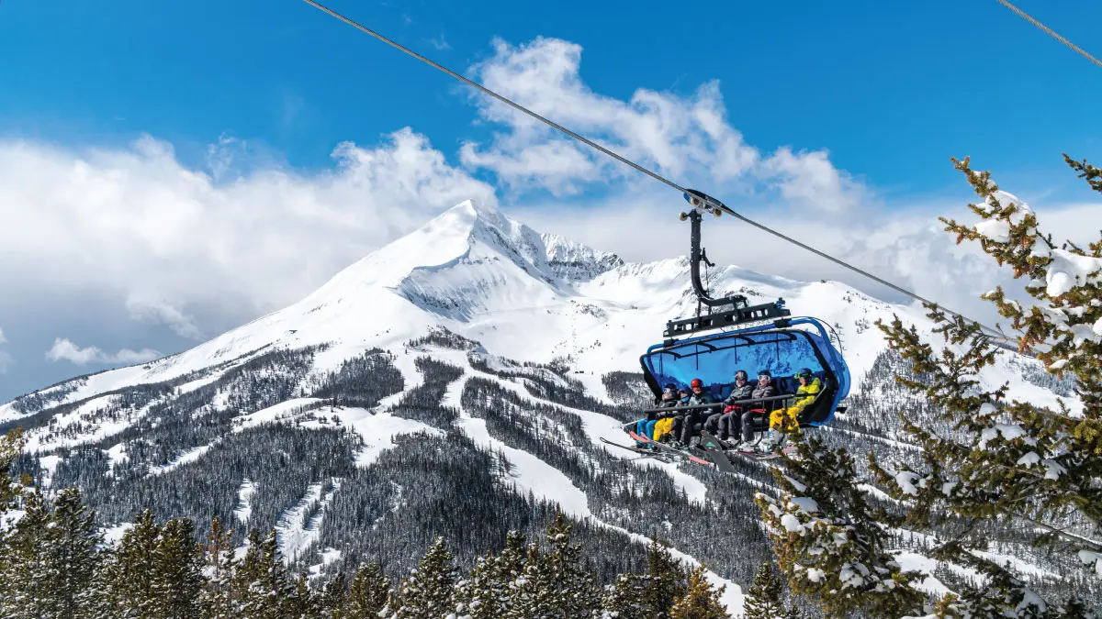
Big Mountain Resort - “Biggest Skiing in America”
Big Mountain is a popular winter destination for skiers and snowboarders.
Gateway to Montana’s Great Outdoors: Glacier National Park and Flathead National Forest
Mountain Stats:
~350,000 people ski or snowboard here every year!
105 trails 11 lifts, 2 T-bars, and 1 magic carpet for novice skiers.
Longest run (“Hellfire”): 3.3 miles
Base elevation: 4,464 ft,
Summit elevation 6,817 ft
Vertical drop: 2,353 ft.
Current Adult Weekend ticket price: $81
Most expensive in Montana
Notes:
Big Mountain Resort - we are called the “Biggest Skiing in America” for a reason. The pictures are worth 1,000 words but as we can see on the slide here we all know and have experienced the thrill of skiing on our big mountain and all it has to offer.
Note: “Biggest Skiing in America” is the slogan for “Big Sky Resort” in Montana.The pictures I used are also of Big Sky Resort in Montana.

Slide 3
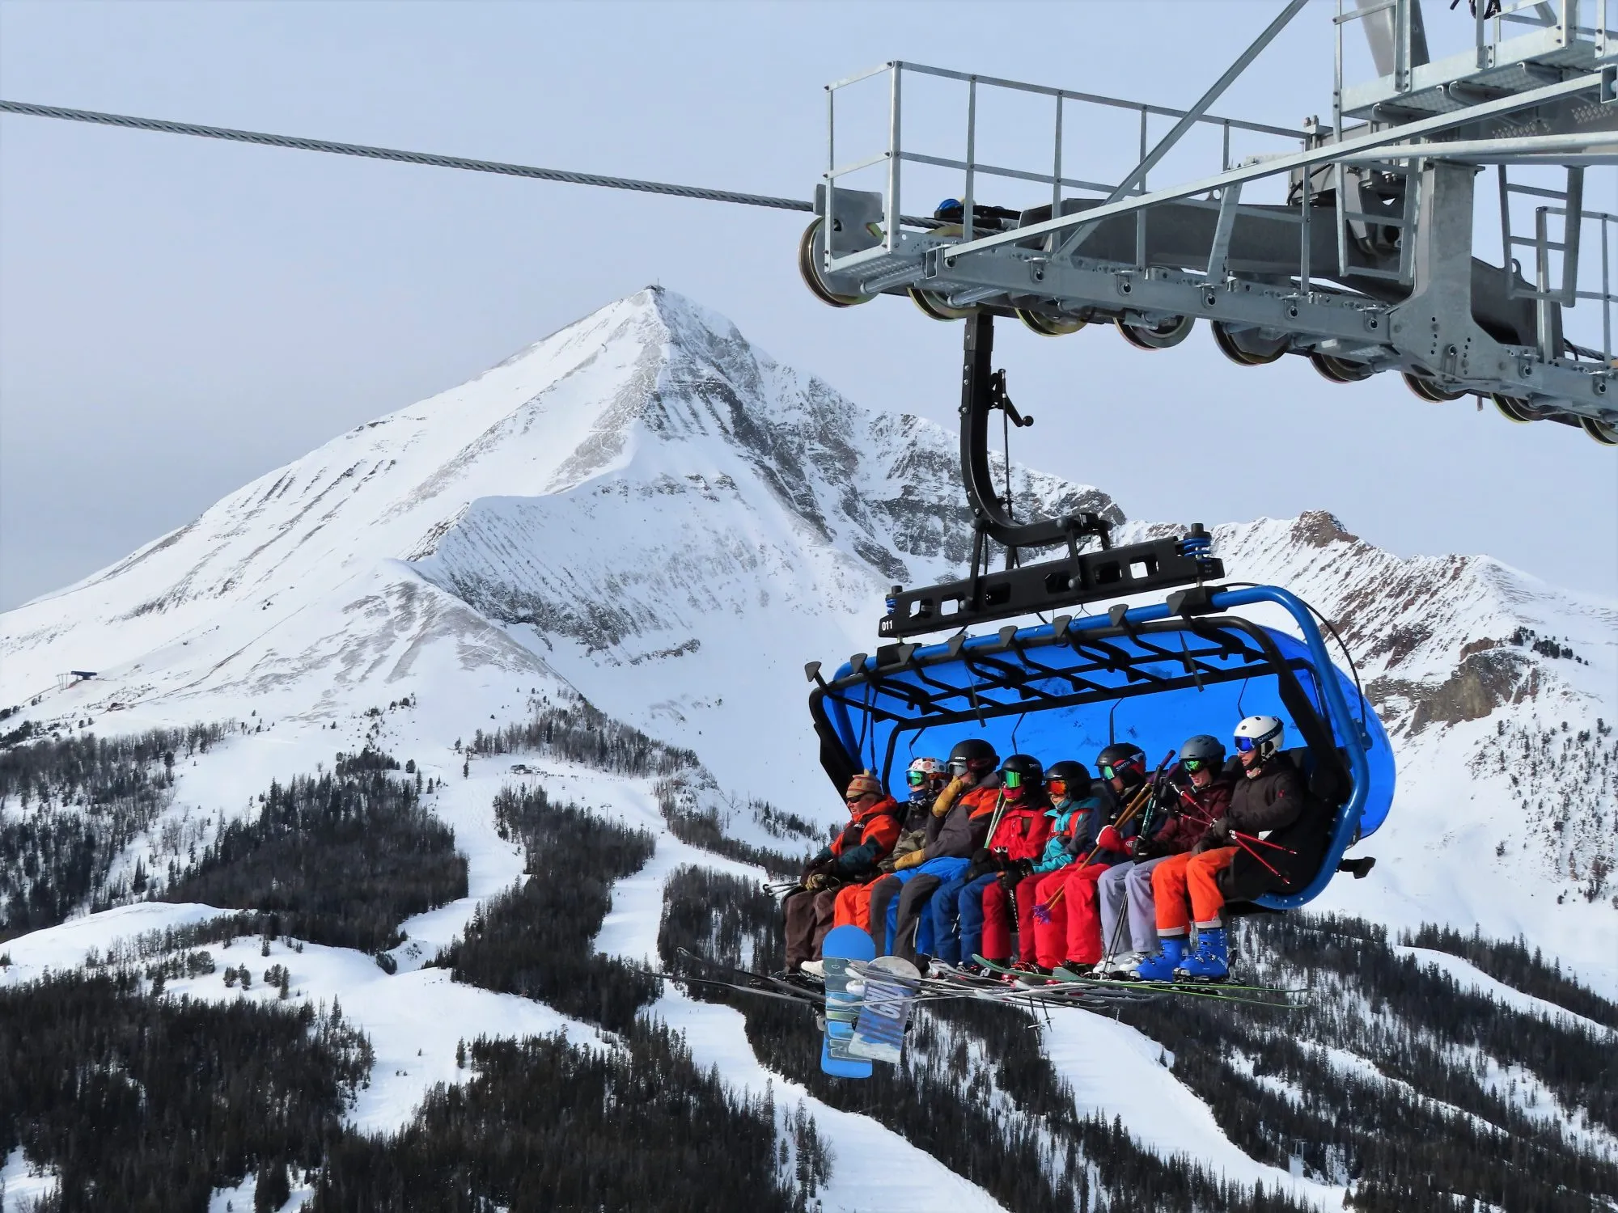
Problem Statement
We installed a new state of the art lift for next season
Increases Lift fleet from 11 to 12
Operational Expenses will increase by ~$1.5 million
Currently lift ticket prices set at a “premium above average price of resorts within our U.S. market segment.”
Question for our stakeholders:
How can we implement a data-driven business strategy to select a better valued lift ticket price for the upcoming ski season that will offset the sudden $1.5 million increase in operating expenses while aligning with the market, customers, and resort facility costs?
New state of the art chair lift at Big Mountain Resort
Notes:
However, we have a financial problem that has come to our attention. We are adding a new state of the art lift this upcoming season that will put us roughly $1.5 million in the hole in operating expenses.
Thus our problem statement above: how can we potentially increase lift ticket prices without going over the market price and still manage to cover our operating expenses?

Slide 4
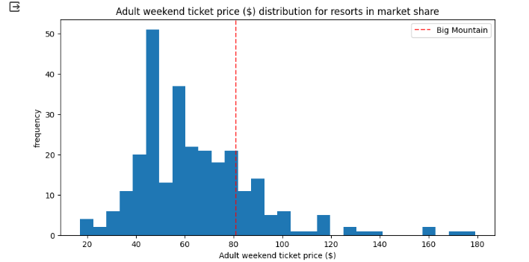
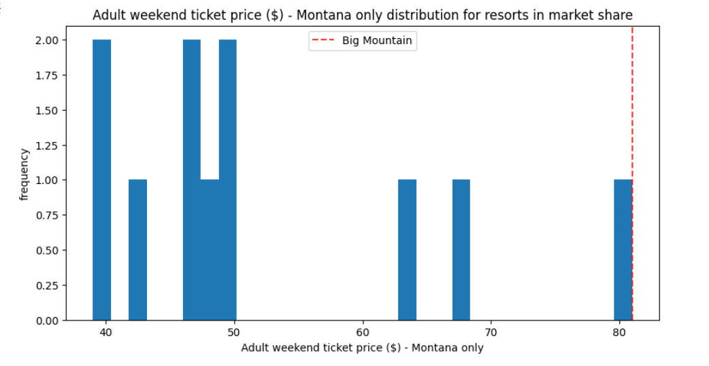
Key Findings
Big Mountain at upper end of "standard ticket prices" (range: $20-$100) - (Fig. 1 - red line)
Big Mountain ticket price is highest price in Montana ($81) compared to average of $40-$50 - (Fig. 2 - red line)
Other Key Findings:
Montana ranks 4th in U.S. in "Resorts per 100k capita" (Vermont #1)
Montana ranks 15th in average weekend lift ticket price (Colorado #1)
Fig. 1
Fig. 2
Notes:
The Data Science team at Big Mountain undertook an investigation that involved looking at 1 large dataset of 330 ski resorts across the United States that are “in our market” in order to compare pricing for weekday and weekend lift tickets but also looked at other operating expense factors other resorts are concerned with.
We can see the first chart above, and the main takeaway? Big Mountain is at the upper end of the standard nation wide prices (red line) at $81 per day.
We can see in the chart below that Big Mountain is the most expensive resort in Montana.
There were some other key findings relative to resorts per capital where we rank 4th, and the overall average ticket price nationwide we are 15th, Colorado is 1st (no surprise with Vail being there!).

Slide 5
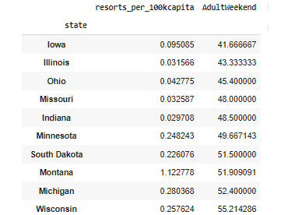
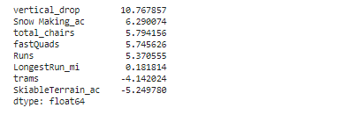
Key Findings
Strong positive correlation for all resorts with vertical drop, Quad lifts, # of Runs, and total chair lifts.
Higher ticket prices with more resorts serving a larger population - higher demand.
Top 3: Utah, Colorado, Vermont
Lower ticket prices seen when a smaller number of resorts serve a population (Fig. 3)
Montana (Big Mountain) is in the top 10
Trams and skiable terrain were negatively correlated with ticket price, thus larger resorts can lower ticket price by accommodating more skiers (Fig. 4)
Fig. 3
Fig. 4
Notes:
So what were other key findings?
Strong correlation seen with vertical drop, number of 4 person lifts, # of runs and total chairs.
The chart to the right Fig.3 we can see lower prices were noted when smaller num of resorts serve a population, our state Montana is in the top 10 lower prices per capita as we sit in a less populated part of the U.S. near beautiful Glacier National Park.
The last chart Fig. 4 we can see that there is a strong neg correlation with skiable terrain and trams. So more terrain results in a lower price - thus a resort like ours with more acres could lower prices as we can support more skiers and boarders.

Slide 6
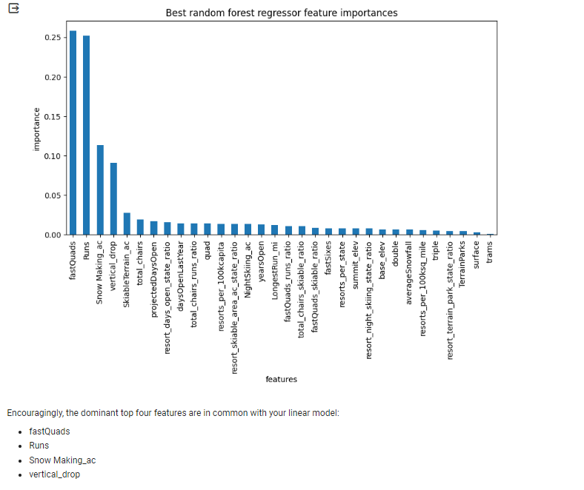
Modeling Results + Analysis
3 models tested:
1. "Dummy Regressor" - used mean of ski resort ticket prices
Result: the mean overpredicts ticket prices by $19
2. Linear Regression Model
Result: predicted within $9 of ticket price
3. Random Forest
Result: most important top 5 features: quads, runs, snow making acreage, vertical drop (fig. 5)
Fig. 5
Notes:
For our modeling we looked at 3 models
Dummy regressor with the mean of ticket prices which over estimated by $19, however this was a starting point.
We then compared a linear regression model to a random forest. The linear model over predicted prices by $9.
In the end we used a random forest regressor that also gave us a ranking of the top features as we can see on the slide.

Slide 7
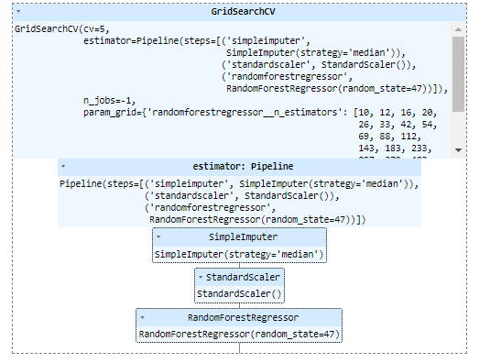
Modeling Results + Analysis
Random forest model = Best Model!
Lowest variance in price prediction by $1 compared to linear regression.
Lowest error seen with a mean absolute error (MAE) of 9.53
Cross-validation was used to validate these results against Linear Regression Models and the MAE was still lower (1.37 vs. 1.62)
Random Forest then used for final predictions and modeling
Used Grid Search CV to determine optimal model hyperparameters (Fig. 6)
Fig. 6
Notes:
These are the results of the best model the random forest.
This model was used as it had the lowest variance between actual and predicted prices and lowest error rate.
Also, we used grid search CV to an algorithm to find the best parameters for our model.

Slide 8
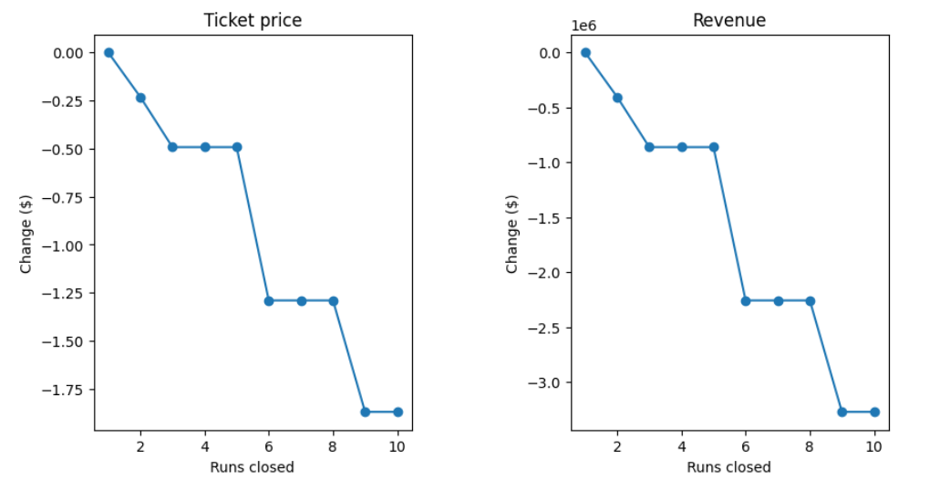
Model Results + Analysis
4 Scenarios - Modeled and Tested
1. Closing ski runs
Close more than 2 or 3 runs resort loses more revenue, up to $2.50 per skier (Fig. 7)
2. Add new ski run + chairlift
Best option!
Why? Increase vertical drop by 150 feet, add new lift increases uphill capacity
Increases ticket price demand/support by $2 per person
Predicted revenue increase by $3.5 million
3. Add 2 acres of snowmaking
no differences
4. Increase longest run by 0.2 miles, add 4 acres of snowmaking
no differences
Fig. 7 - Scenario 1 shows why closing more runs reduces revenue
Notes:
Finally, I present the 4 scenarios we looked at.
Closing ski runs - this is represented by the chart to the right. The basic takeaway here is that the more runs you close the more revenue you will lose per skier/boarder. Thus not a good idea.
The 2nd scenario was adding a trail and a lift to increase skier capacity on the mountain and uphill. The biggest takeaway is a $2 increase in weekend ticket prices but it can result in potentially $3.5 million in revenue increase for the next season that offsets the predicted $1.5 million loss from the new lift.
3rd scenario looked at adding snowmaking (2 acres) which no difference noted.
4th and final scenario looked at increasing longest run by 0.2 miles add 4 acres snowmaking? No difference.

Slide 9
Recommendations
Suggested ticket price: $96.32
Models also suggested increasing prices by $10.41
Big Mountain is in the "upper tier" for 7 operational dependencies for ski resorts in our market.
Is this a major area for cost savings?
Best Option:
Implement new lift and new trail.
Increase ticket prices by $2 to $81 per day on weekends
Overall this predicts revenue increase of $3.5 million for next season
Notes:
Final recommendations are seen above.
Models suggested a price of $96.32 and some suggested increasing our prices by $10.41.
Models also showed us that our resort sits in the upper tier for 7 operational dependencies which certainly explains why we have high operating expenses. Something we need to look into.
Overall we discussed the best option of the new lift, new trail, increase price $2 on weekends for adults to increase revenue by $3.5 million.

Slide 10
Summary + Conclusion
Short Term - Next Ski Season
Increase Adult weekend ticket prices by $2 to $83 per day.
Add 1 new trail and the new lift => increase customer demand and support for ticket => $3.5 million revenue increase!
Begin A/B testing for increasing Adult weekend ticket prices by $2
Long Term - Future Work
Overall: we need more data, such as:
Customer demographics
Weekday prices, holiday prices, multi-day tickets, etc…
Multi-resort passes (Epic, Ikon, etc.)
Big Mountain's individual operating expenses
Continue to update data and models
Continue to keep “pulse” on ski resort market prices

Slide 11
References
All, M. 2023. "Understanding Data Drift and Model Drift: Drift Detection in Python." Retrieved from: https://www.datacamp.com/tutorial/understanding-data-drift-model-drift
Molas, A. 2022. “Can Random Forests Overfit?” Retrieved from: https://medium.com/@alexmolasmartin/can-random-forests-overfit-a743755251b4
Natarajan, M. 2023. "A/B Testing in Machine Learning: Unraveling the Experiment." Retrieved from: https://medium.com/@megha.natarajan/a-b-testing-in-machine-learning-unraveling-the-experiment-10780228cfb4#:~:text=Understanding%20A%2FB%20Testing%20in%20Machine%20Learning&text=Here's%20where%20A%2FB%20testing,predictions%20from%20the%20new%20model.
Ram, S. 2020. “Mastering Random Forests: A comprehensive guide." Retrieved from: https://towardsdatascience.com/mastering-random-forests-a-comprehensive-guide-51307c129cb1
Zhou et al, 2021. “Trees, Forests, Chickens, and Eggs: When and Why to Prune Trees in a Random Forest.” arXiv:2103.16700v1 [stat.ML] 30 Mar 2021

